Slide 1




MicroProfile 5.0
7th Dec, 2021
MicroProfile Community
Copyright © 2021, Eclipse Foundation, Inc. | Made available under the Eclipse Public License 2.0 (EPL-2.0)

Slide 2
What is MicroProfile?
MicroProfile is an open-source community specification for Enterprise Java microservices
A community of individuals, organizations, and vendors collaborating within an open source Eclipse Foundation Working Group to bring microservices to the Enterprise Java community

Slide 3
MicroProfile Working Group
In October 1st, 2020, MicroProfile became a member of the Eclipse Working Group to close its intellectual property gap
The MicroProfile Charter defines the MicroProfile Working Group vision and scope, governance, membership, and more.
MicroProfile component specifications follow the MicroProfile Specification Process, a compatible specialization of the Eclipse Specification Process.
MicroProfile 4.1 is the first release delivered under the MicroProfile Working Group with compatible implementation declared

Slide 4
Release Compatible Implementation
Defined the compatible implementation for MicroProfile 5.0
[Required] Passing the 8 MicroProfile Specification TCKs
MicroProfile Config 3.0
MicroProfile Fault Tolerance 4.0
MicroProfile Health 4.0
MicroProfile JWT Authentication 2.0
MicroProfile Metrics 4.0
MicroProfile OpenAPI 3.0
MicroProfile OpenTracing 3.0
MicroProfile Rest Client 3.0
[Optional] Passing the 5 Jakarta Specification TCKs
CDI (Jakarta Contexts and Dependency Injection) 3.0
JAX-RS (Jakarta RESTful Web Services) 3.0
JSON-B (Jakarta JSON Binding) 1.0
JSON-P (Jakarta JSON Processing) 2.0
Jakarta Annotations 1.3
Use Java SE 8 or higher

Slide 5











Working Group Corporate Members

Slide 6









Current MicroProfile Implementations

Slide 7
MicroProfile 5.0 Released!
Released 6th Dec 2021
Offered in the release:
Updated all eight MicroProfile Component specifications to align with Jakarta EE 9.1
Release

Slide 8
MicroProfile 5.0 (Dec 7th 2021)
Standalone
Open Tracing 3.0
Open API 3.0
Rest Client 3.0
Config 3.0
Reactive Messaging 2.0
Fault Tolerance 4.0
Metrics 4.0
JWT Authentication 2.0
Health 4.0
Reactive Streams Operators 2.0
Jakarta CDI 3.0
Jakarta JSON-P 2.0
Jakarta JAX-RS 3.0
Jakarta JSON-B 2.0
Context Propagation 1.3
Jakarta Annotations 2.0
GraphQL 1.1
MicroProfile 5.0
LRA 1.0
= New
= Updated
Outside umbrella
= No change from last release (MicroProfile 4.1)

Slide 9
MicroProfile Config 3.0
Provides an easy to use and flexible system for application configuration
What's new
Updated to use Jakarta EE 9 dependencies
Backwards incompatible changes
More ...
Specification release (changes)

Slide 10
MicroProfile Fault Tolerance 4.0
Defines easy to use and flexible APIs for building resilient applications
What's new
Updated to use Jakarta EE 9 dependencies
Backwards Incompatible changes
More ...
Specification release (changes)

Slide 11
MicroProfile Health 4.0
Expose the availability of a MicroProfile runtime to underlying platform
What's new
Updated to use Jakarta EE 9 dependencies
Backwards Incompatible changes
More ...
Specification release (changes)

Slide 12
MicroProfile JWT RBAC 2.0
Using OpenID Connect(OIDC) based JSON Web Tokens(JWT) for role based access control(RBAC) of microservice endpoints.
What's new
Updated to use Jakarta EE 9 dependencies
Backwards Incompatible changes
More ...
Specification release (changes)

Slide 13
MicroProfile Metrics 4.0
Define custom application metrics and expose platform metrics on a standard endpoint using standard formats
What's new
Updated to use Jakarta EE 9 dependencies
Backwards Incompatible changes
More ...
Specification release (changes)

Slide 14
MicroProfile OpenTracing 3.0
Trace request flows between service boundaries
What's new
Updated to use Jakarta EE 9 dependencies
Backwards Incompatible changes
More ...
Specification release (changes)

Slide 15
MicroProfile OpenAPI 3.0
Provides Java interfaces and programming models to natively produce OpenAPI v3 documents from JAX-RS applications
What's new
Updated to use Jakarta EE 9 dependencies
Backwards Incompatible changes
More ...
Specification release (changes)

Slide 16
MicroProfile Rest Client 3.0
Type-safe rest client defined as Java interfaces
What's new
Updated to use Jakarta EE 9 dependencies
Backwards Incompatible changes
More ...
Specification release (changes)

Slide 17
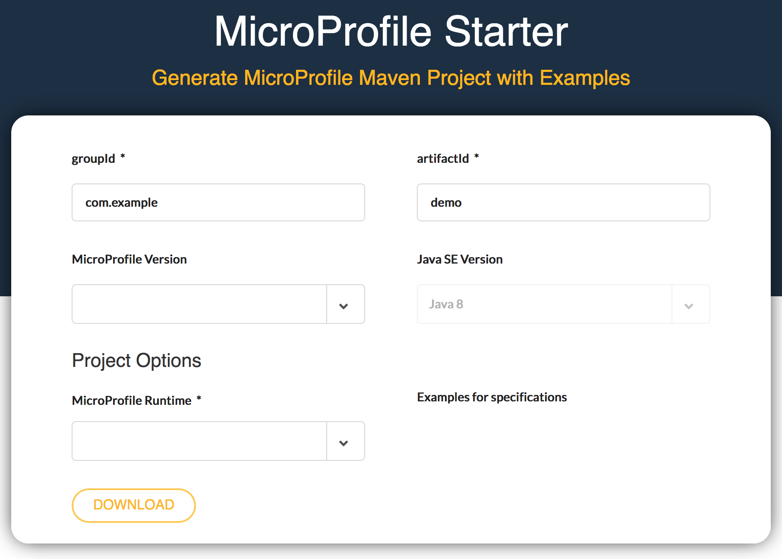
start.microprofile.io
Generate MicroProfile projects
Visual Studio Code plugin
Intellij Plugin
Command line tooling

Slide 18
MicroProfile Reactive Capabilities
MicroProfile Reactive Streams Operators
A set of operators to create new reactive streams, process the transiting data and consume them with ease
MicroProfile Reactive Messaging
Defines a development model for declaring CDI beans producing, consuming and processing messages. It relies on Reactive Streams Operators and CDI
MicroProfile Context Propagation
APIs for propagating contexts across units of work that are thread-agnostic
Reactive Streams Operators 2.0
- Project page - Spec PDF doc - Spec HTML doc - Technology Compatibility Kit (TCK)
MicroProfile Reactive Messaging 2.0
- Project page - Spec PDF doc - Spec HTML doc - Technology Compatibility Kit (TCK)
Context Propagation 1.3
- Project page - Spec PDF doc - Spec HTML doc - Technology Compatibility Kit (TCK)
Standalone Specifications

Slide 19

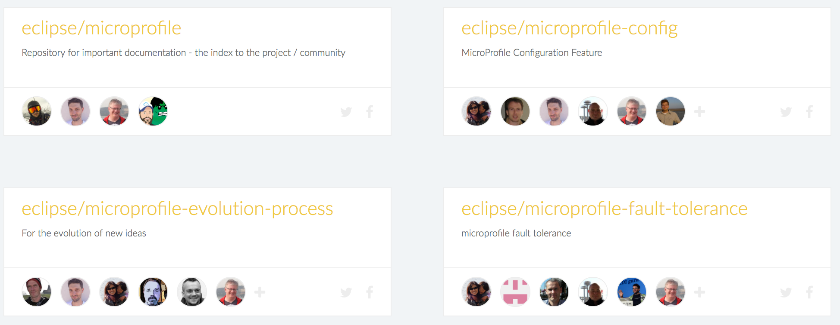



Get Involved!
Google Groups
MicroProfile Projects
Bi-Weekly & Quarterly
General community
Meetings
Video Hangouts
YouTube Channel

Slide 20
MicroProfile
Copyright © 2021, Eclipse Foundation, Inc. | Made available under the Eclipse Public License 2.0 (EPL-2.0)

